Slide 1
COVID-19 Big-Data Analysis
Course: CPSC 531- Advanced Database Management
Section No: 3
Team Members:
Name CWID
Debdyuti Das 886676550
Shriya Bannikop 885196238

Slide 2
Background
The risk of coronavirus was still increasing even after the government had taken several measures worldwide to minimize the Covid-19 spread. The transmission chain's severity was deemed broken only when no new case was reported in an area. The only way to break the transmission chain is to impose a Lockdown.
Observe trend in the data based on the increasing number of cases
Was imposing lockdown a right decision
Compare countries which imposed lockdown and analyse the variation in the number of covid 19 cases

Slide 3

Problem Statement
To compare and analyze the variation in the number of COVID-19 cases in countries which imposed complete lockdown with restriction rules and observe the trend.

Slide 4
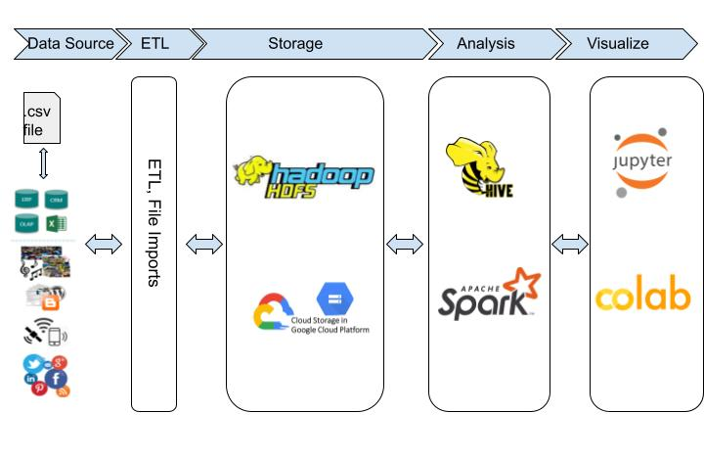
Architecture
Big data technologies utilised in Cluster created on Google Cloud platform(dataproc)
.csv files as input
Data ingested into HDFS stored in google cloud storage buckets
Extract Data in Hive,Spark for analysis
Analysed data visualised in Google Colab, jupyter notebook
Notes:
HDFS Data ingestion from csv files and transfer data from hive used for analysis using spark
Spark to distribute data across cluster and parallel processing of the data

Slide 5

Technologies and Tools
Primary Storage System: Hadoop Distributed File System
Cloud Platform: Google Cloud Cluster
Distributed processing System: Apache spark
ETL Tools: Hive
Visualization: Google Colab, Jupyter notebook

Slide 6

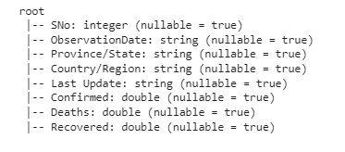
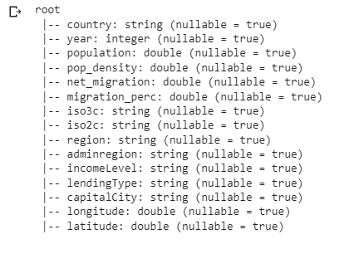
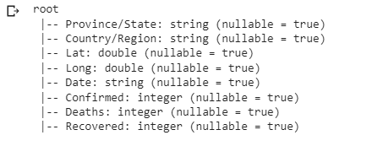
Dataset Schema
Data Source: WHO
Input format: .csv file

Slide 7
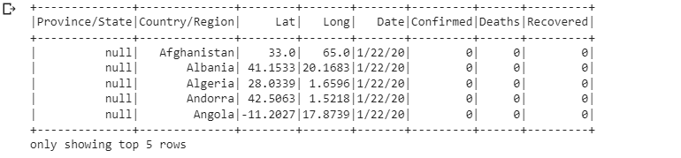
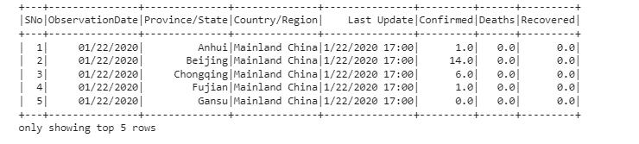
Data

Slide 8
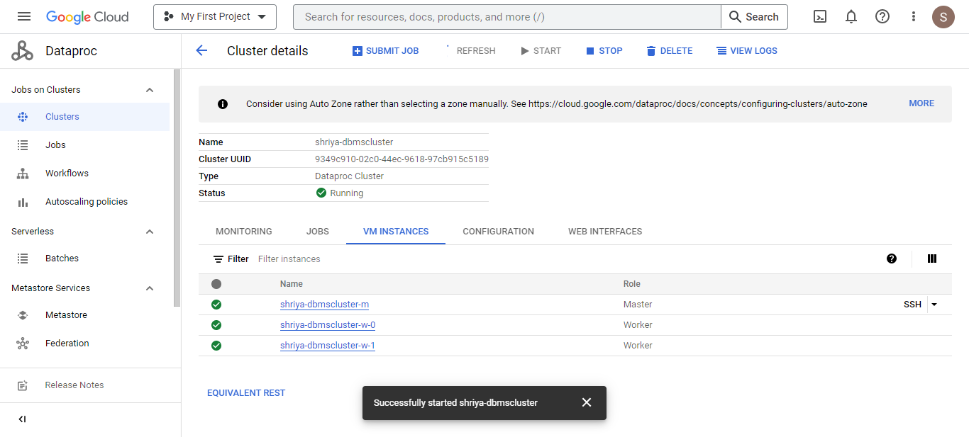
Google Cloud cluster creation

Slide 9
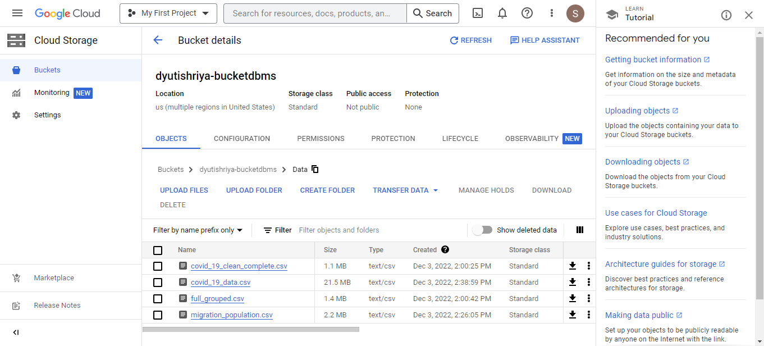
Google Cloud Storage

Slide 10
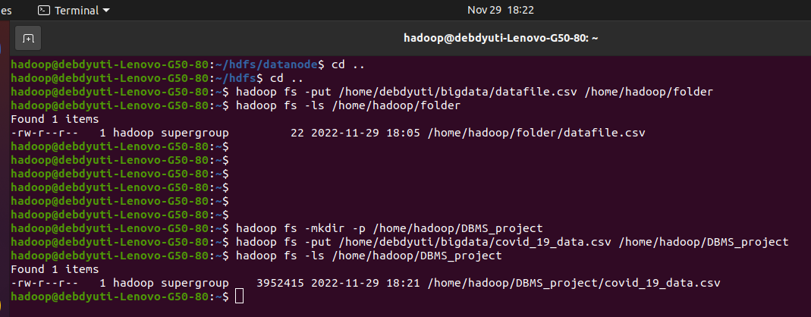
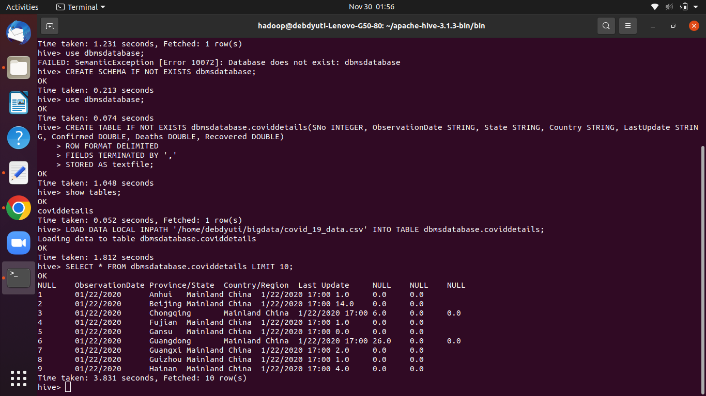
Table Creation-Hive
Move csv file to HDFS location from local
Create table in hive
Load data into table

Slide 11
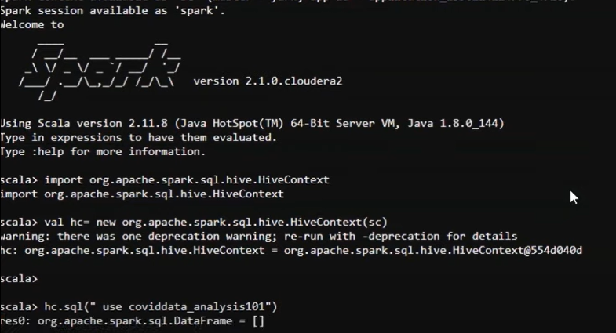
Moving Data from Hive to Spark for Analysis

Slide 12
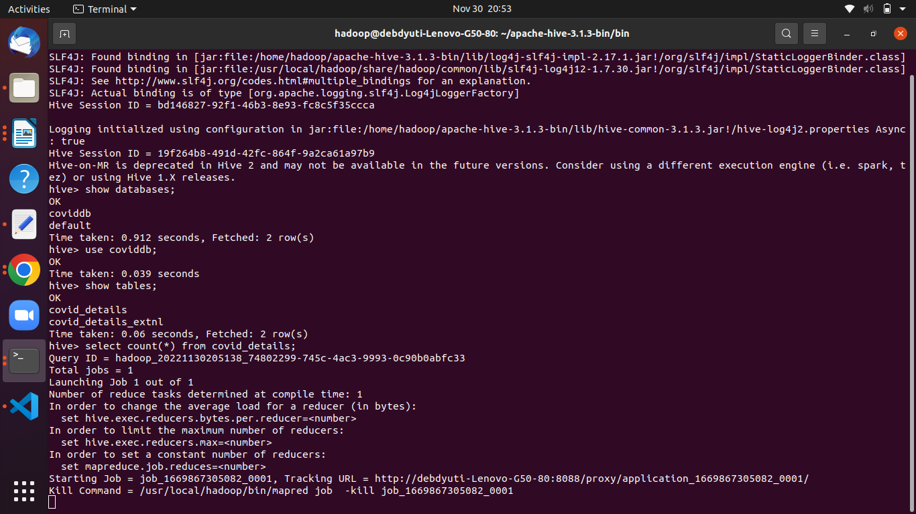
MapReduce-Hive, HDFS

Slide 13
Analysis-Spark

Slide 14
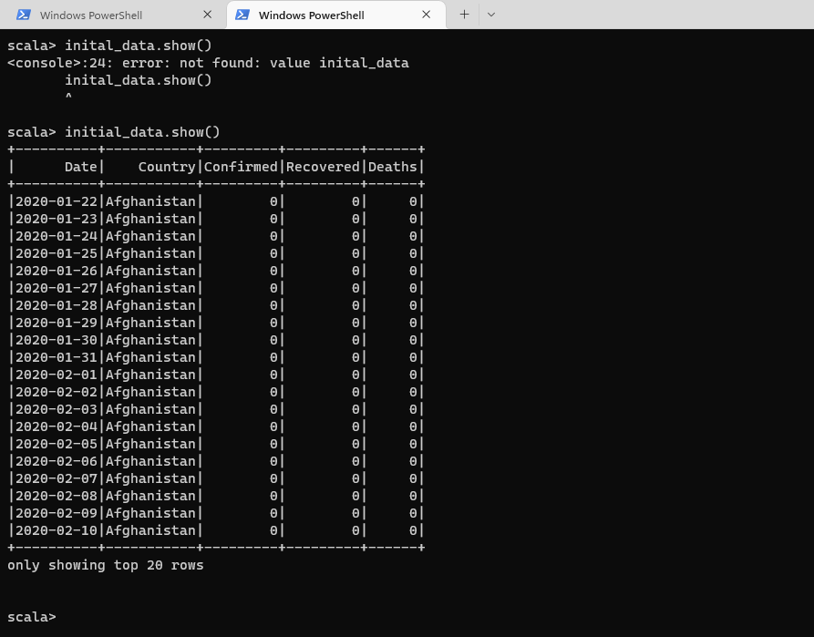
Data Cleaning
Fill na with unknown
Filter data
Convert string data to date

Slide 15
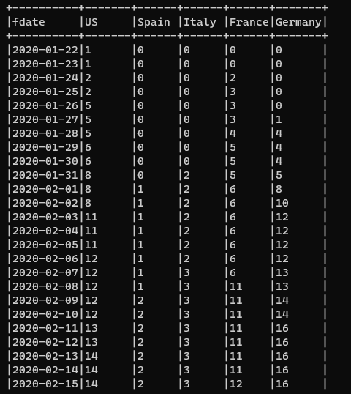
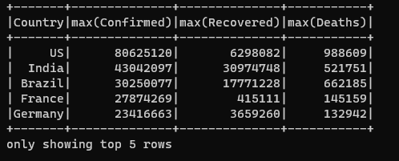
Data exploration
Find top 5 countries
Pivot table by country
Number of cases

Slide 16
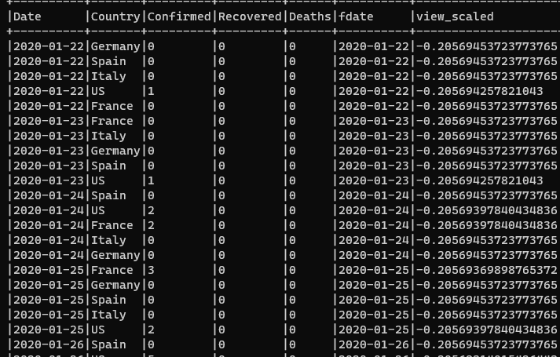
Data Preparation
Scaling values to remove outliers

Slide 17
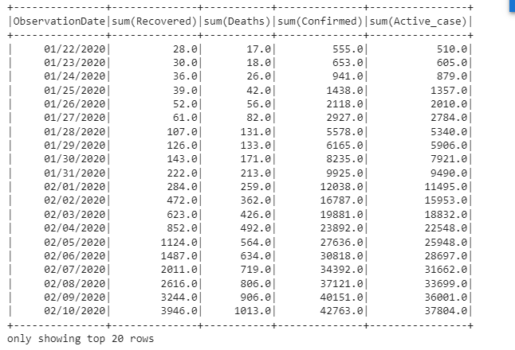
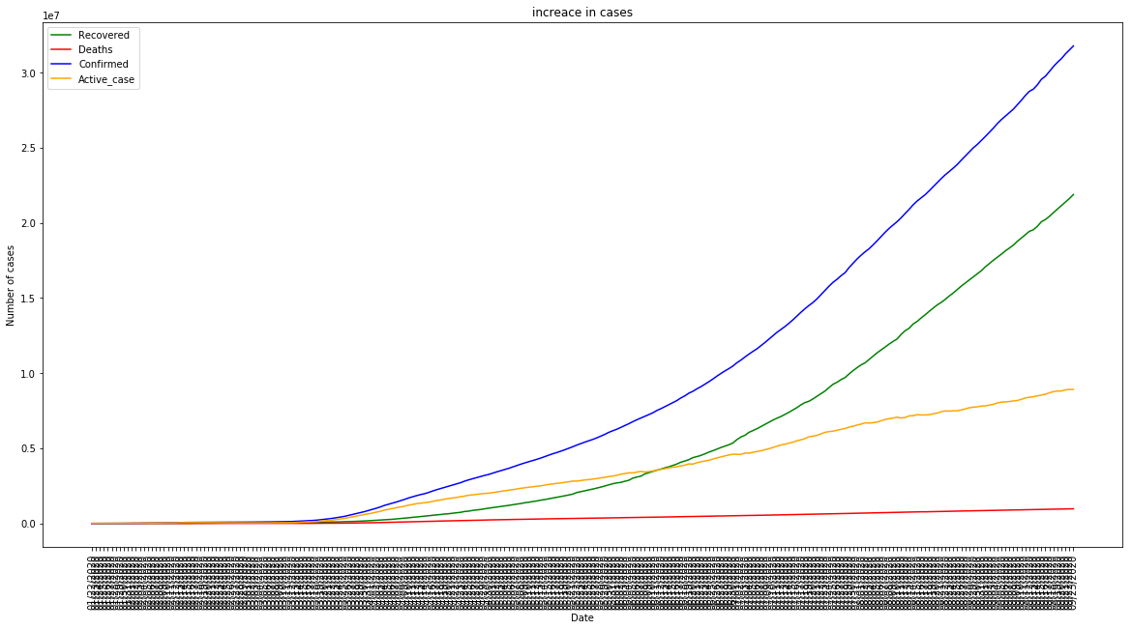
Analysis

Slide 18
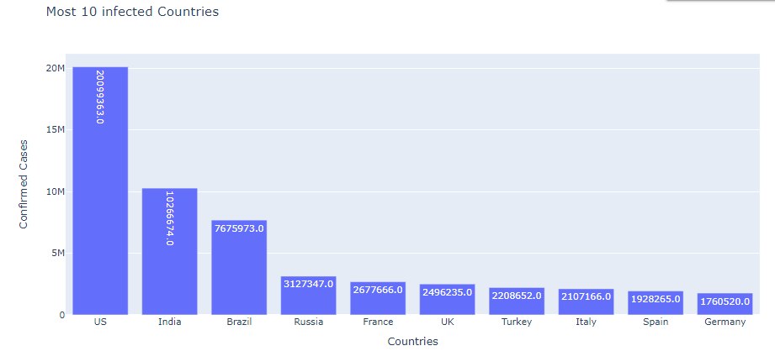
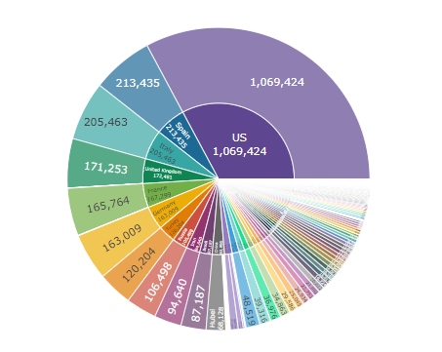
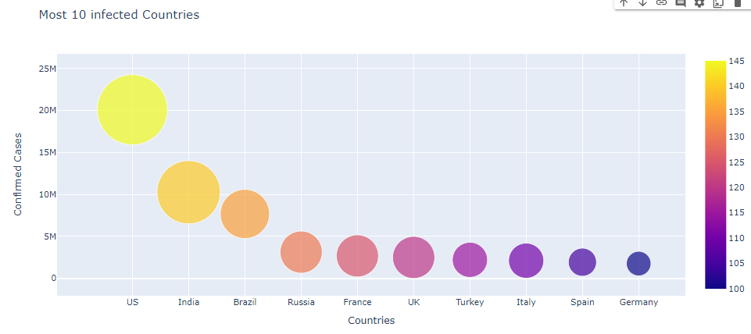
Confirmed Cases
Top 10 country sorted by maximum number of confirmed covid cases
Confirmed covid cases in year 2020 for each country

Slide 19
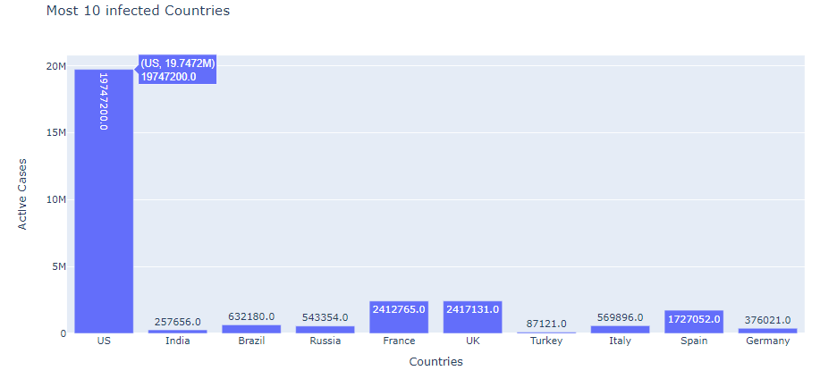
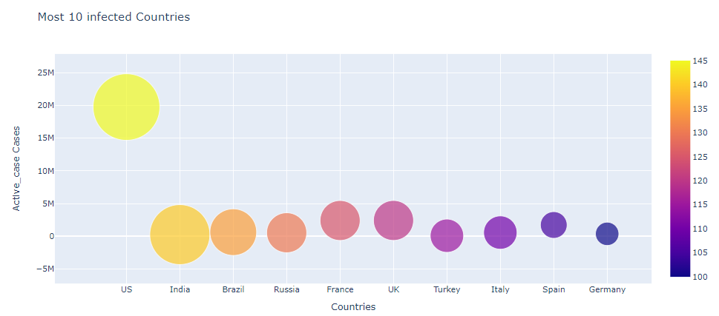
Active Cases
Top 10 country sorted by number of active covid cases
Total number of active cases in each country

Slide 20
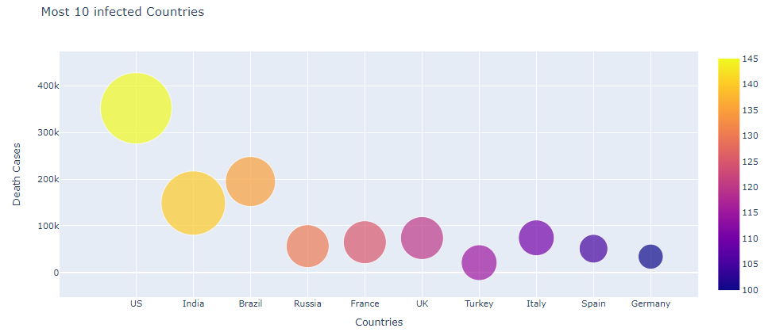
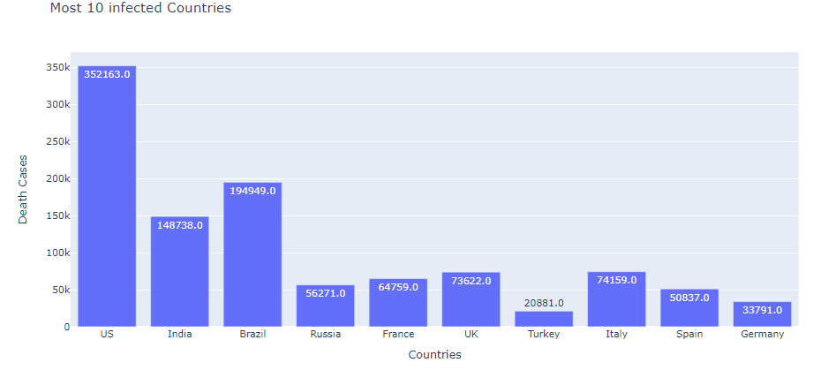
Deaths
Top 10 country sorted by covid death rate
Total number of deaths in each country

Slide 21

Future Scope
Further Analysis
Apache Sqoop integration
Mysql integration
Visualization

Slide 22
References
https://media.istockphoto.com/id/1215768524/vector/all-the-world-lock-down-and-stay-at-home-with-cross-line-lock-down-and-physical-distancing.jpg?s=612x612&w=0&k=20&c=IMUtLnhL9T4Du9ncS5osxslfWGG9VGNMApOyY-qG0tY=
https://www.google.com/url?sa=i&url=https%3A%2F%2Fdatafloq.com%2Fread%2Feverything-you-need-to-know-about-big-data-2020%2F&psig=AOvVaw1nNAfqlgVI2UFsb8RPO47v&ust=1670017670722000&source=images&cd=vfe&ved=0CA8QjRxqFwoTCLjkreKy2fsCFQAAAAAdAAAAABAE
https://bigdataprogrammers.com/load-csv-file-in-hive/

